Slide 1
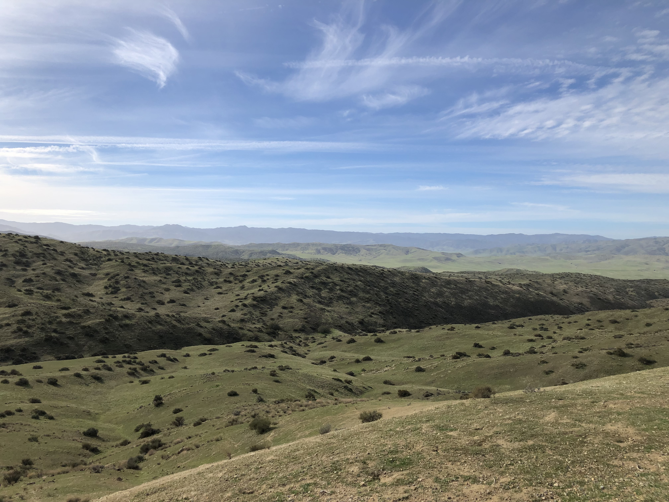
An examination of shrub and animal density-dependent interactions in desert ecosystems: April Progress Report
By: Mario Zuliani

Slide 2
Review of Chapter Timeline
Chapter | Title | Progress | ST Goals | LT Goals
1 | Making a deal with the Devil | Literature review started September 2018 | Collect preliminary data and have reviewed/analyzed by December 2018/January 2019 | Analyses complete by July/August 2019. Draft by September 2019?
2 | An examination of shrub and animal density-dependent interactions in desert ecosystems | Field Season to start May 2019 | Data analysis by September/October 2019 | Second field season May 2020?

Slide 3
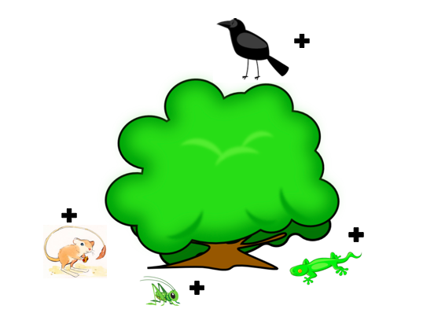
Theory
Notes:
For a quick reminder of what my project entails im going to go through very briefly about some of the background associated with my project.
Positive interactions between plants and animal species have been reported in most ecosystems globally. This positive interaction is defined as a non-trophic interaction between species where at least one of the interacting species has a positive benefit to their overall fitness, and the other remains unaffected. The term most frequently used to describe this interaction is Facilitation. As long as one of the interacting species does not experience any negative effects that could hinder its overall survival. It is proposed that in arid environments (the type of environment I will be conducting my research) this interaction occurs much more frequently and that species in these areas would not be able to survive without this interaction.
Shrubs are able to facilitate these positive interactions with animal species by providing a variety of direct and indirect benefits . Direct interactions such as acting as a resource, protecting from predators and acting as a refuge, are jusr some minor examples of how these woody shrubs can benefit animal species. As for indirect interactions, shrubs provide a “microclimate” that are usable for species to escape the extreme heat in these arid ecosystems.

Slide 4
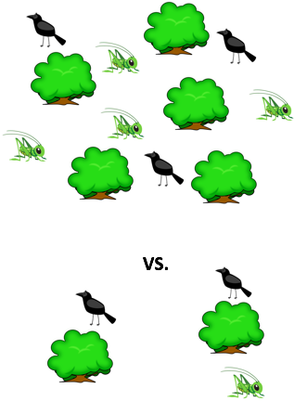
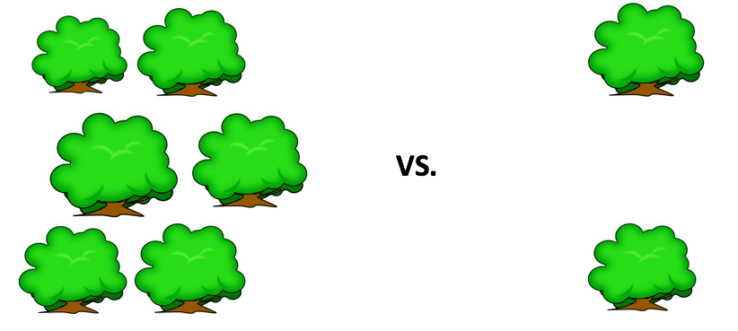
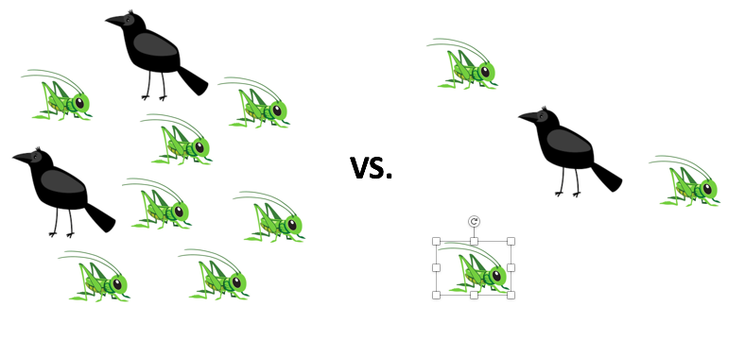
Notes:
Density is defined as the total number of individuals in a given area, per unit area. Therefor shurb and animal densities can be defined as the total population of a shrub or animal population in a given area. The density of shrubs in these arid environments vary heavily from area to area. In some, there may be as many as 5 shrubs in a 10m radius. IN contrast, there could be 0-1 shrubs in the same area. There has been a significant lack of studies conducted on the relationship between shrub density and animal density, especially in these arid ecosystems. It is possible that due to the facilitation that occurs between shrub and animal species, that a higher shrub density can have an affect on the total animal densities in these areas.
Animal Density in ecosystems is important for the individual animals species. If we have a higher density of a specific animal species, then there is a higher chance for interactions to occur between them. For example, there can be higher chances of individuals mating when the population density of that specific species is fairly high. However with this increase in animal density, there may also be an increase in competition for food supplies and possibly predation. This is opposed to lower animal densities. With a lower density of animals, there may be less competition for resources and a decreased predation, however there will also be a decreased in positive intraspecies interactions, such as mating
The main overarching theme of my study is to determine whether or not the density of shrubs willhave an impact on the total

Slide 5

Chapter 1: Making a Deal with the Devil
Purpose:
A systematic review to gain insight on the relationship between shrub and Animal densities recorded in literature
Focus on papers where facilitation occurs and if densities are recorded
Notes:
My chapter one is going to be a systematic review focusing on gaining insight on the relationship between shrub and animal densities in literature. The main focus will be to see if literature that touches upon facilitation included densities in its records. The main questions that will be focused in during this review will be Read questions

Slide 6

Chapter 1: Making a Deal with the Devil
Questions:
What activities are being observed with shrubs?
If there are interactions then is only one species benefiting?
Direct and indirect effects?
Are shrub and/or animal densities recorded?

Slide 7

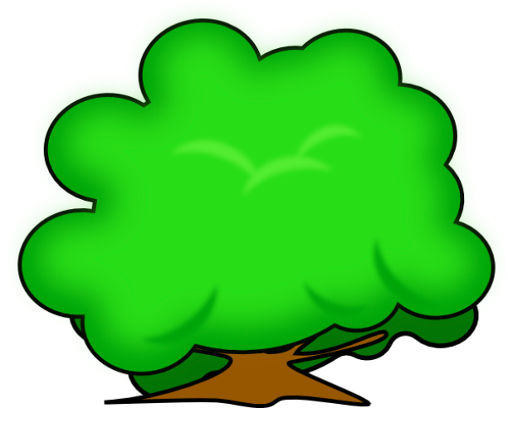
Chapter 1: Making a Deal with the Devil
Predictions:
Many studies are going to focus solely on benefactor interaction
Costs to benefactor species will be overlooked in most papers
Shrub densities will not be focused on or included
Notes:
State Predictions

Slide 8

Chapter 1: Making a Deal with the Devil
Methods:
Web of Science Screening
Generation of bar graphs and PRISMA
Zotero Paper loading
Screen eligible papers
Systematic Review write up
Notes:
In order to find articles usable for the systematic review, Web of Science was used to begin with the preliminary screening of potnetial literature. Use of key words such as shrub* facilitate* density* arid*, etc were used. From there bar graphs were generated to compare the number of papers associated with different combinations of key words and a PRISM to help display the filtering process of potential literature that will be used.

Slide 9

Chapter 1 Progress so Far
Total papers reviewed = 375
Total after Abstract and Full text review = 37
Criteria for filtering:
What field of study is the paper focusing on
Is density, facilitation and shrub mentioned in the abstract
Is there density data usable in the paper
Are the benefactor and protégé species mentioned
Do the papers pertain to the field of ecology.
Notes:
I will go over the filtration of papers in just a moment but I just wanted to highly the beginning and end of the paper review. I first started with 375 eligible papers and filtered through title, abstract and the full text to get a final number of 37 eligible papers.
To get here I followe the following Criteria
While going through text review I looked for a few key factors in the paper that would prove useful for the systematic review. First, I wanted to ensure the remaining papers included a measure of shrub density. Almost all the papers included some measure of density. Unit of density measurement was then recorded to see the differing methods of calculating the overall abundance of shrubs in these varying papers. Finally, I ensured that the papers I was going through for the systematic review were able to conclude, or were able to make connections to facilitative interactions. To do this I determined whether or not the papers concluded that this was occurring in their system. If the paper concluded that facilitation was evident then it was denoted with a Yes, and if they concluded that there were no facilitative interactions, it was denoted with a No.

Slide 10
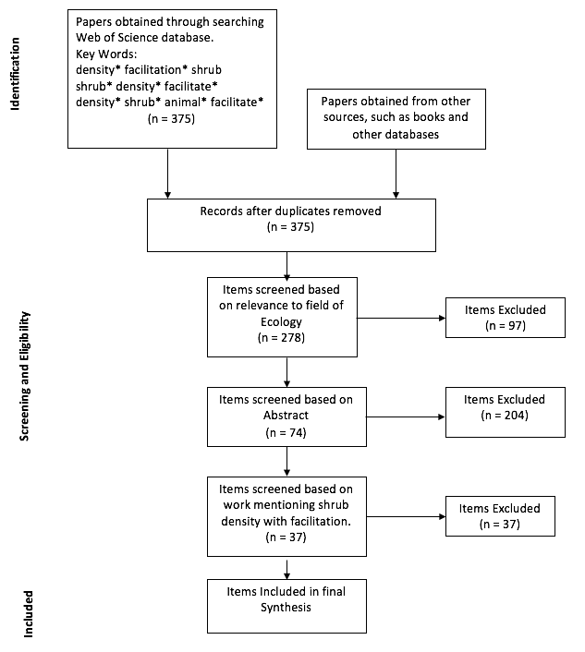
Chapter 1: Progress to Date: PRISMA
Notes:
When I last presented my Prisma I was only at the filtering portion, where I filtered out my searches to the relevant fields (Ecology and agriculture). Now I have gone through the other steps for filtering out relevant papers for my review. I began with abstract review and looked for various key words in the abstracts including facilitate, density, and shrub. I filtered through the 278 papers and was left with around 74 that could potentially be used fof my chapter 1.
After this I began the full text review where I checked to make sure that the papers include the following: is facilitation a focus of the study, is there data for facilitation, was density looked at in the study, is there data pertaining to density, what units were used to measure density in the paper, were shrub species the focus of the study and if so what species, what were the protégé species’ taxa and what are the species themselves. After filtering the papers for the previous data I came up with a total of 37 papers that contain data useable for the systematic review.

Slide 11
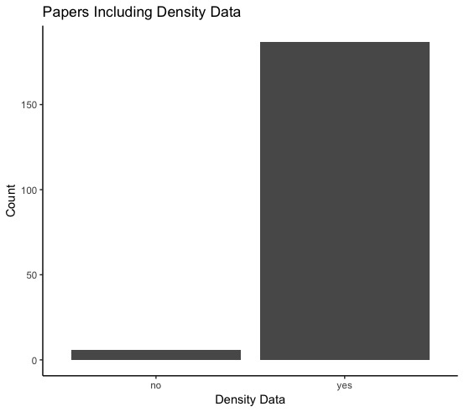
Chapter 1 Progress so Far Cont.
Notes:
The first thing I wanted to outline from my findings is which papers contained density data that can be used for my Chapter 1. Of the 37 papers selected, a total of 31 of them contained a physical value for shrub density. Of these 31 papers, a total of 188 data points have been extracted, pertaining to density in these papers. There were only a total of 6 papers that did not include a value for shrub density, however I decided to include them in the review. This is because they do mention that density was considered when conducting their experiment, however, they never produced a physical value for this data. I decided to keep the paper as it does show that density of shrubs is still being taken into consideration during the conduction of some experiments and the concepts mentioned in these papers are excellent to include.

Slide 12
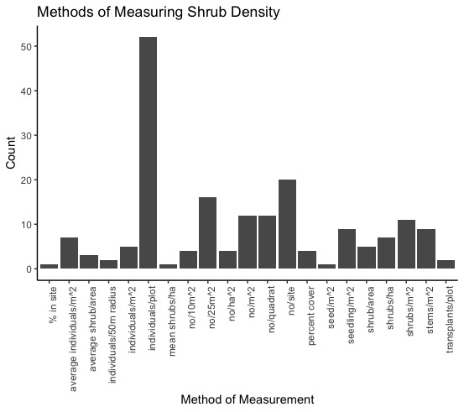
Notes:
The next thing I looked at was how the measurements for density in these papers are recorded. The first thing I noticed is that there is no universal unit or method in which shrub density is measured. It seemed that all of the papers had their own way of quantifying/measuring the density. This entirely depended on the sites they were studying. For example, one study looked at the number of individuals per plot where as another looked at the mean shrub/ha. It is evident that the studies define the total number of shrubs depending on the size of their site. Only in one instance did I see a paper that looked at the percentage of shrub species in their site, as opposed to actually measuring the number of individuals.

Slide 13
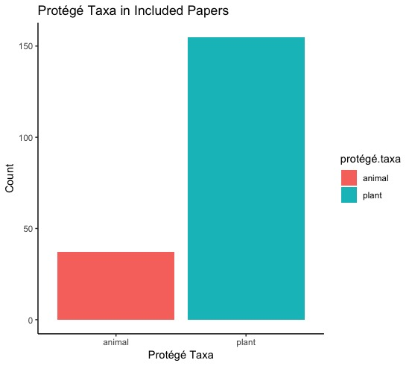
Notes:
I also decided to take a look at the protégé taxa being examined in each of the papers. The graph shows the total number of data points extracted from these papers and which data points represent which taxa. It is evident to see that a vast majority of the papers and data pertain to Plant species as being the Protégé taxa in their papers, suggesting that density measurements are much more prevelent in papers that are examining plant-plant interactions. This is not to say that plant-animal interactions are completely overlooked and that animals are not considered as protégé taxa. Under 50 data points of the total 197 pertained to animal spcies suggesting that plant-plant interactions are not the only types of interactions being taken into consideration.

Slide 14
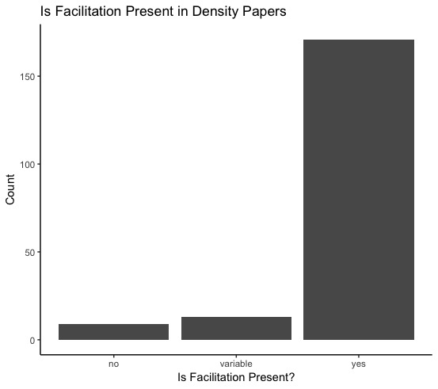
Notes:
The next thing I took a look at was if the papers concluded that facilitation is present in their study or not. This was a focus since my chapter 1 wants to see if density is being recorded in facilitation papers and from the data listed here I would say yes they do. Now keep in mind that this is a representation of papers that have density data present. As you can see of the 196 data points extracted from the articles, almost all of them conclude that facilitation is present. However there was one paper that concluded that there is no facilitation. The reason why I decided to include this paper is for 2 reasons. 1) it has density data that is useable for the study and 2) the paper predicted and was specifically looking to see if facilitation was present. The middle column labeled Variable is a special case. This paper concluded that depending on varying conditions, such as location, temperature, etc, then facilitation may or may not occur. I thought this would be an interesting addition since they somewhat conclude that facilitation is present in their system.
I just wanted to remind everyone that the main purpose of this is to see a density-density relationship (that being of the relationship between the shrub density and the examine protégé species. In some of the papers the density of the protégé species is recorded but in many others only the shrub density is included.

Slide 15
Chapter 1: So What Do We See so Far?
Many of the papers focusing on facilitation and shrub density report a value for shrub density.
Most papers do not have a numeric value to quantify facilitation
There is no universally agreed upon unit of measurement for shrub density, and can vary greatly depending on the study
Many papers looking at density and facilitation conclude that facilitation is present in their system

Slide 16
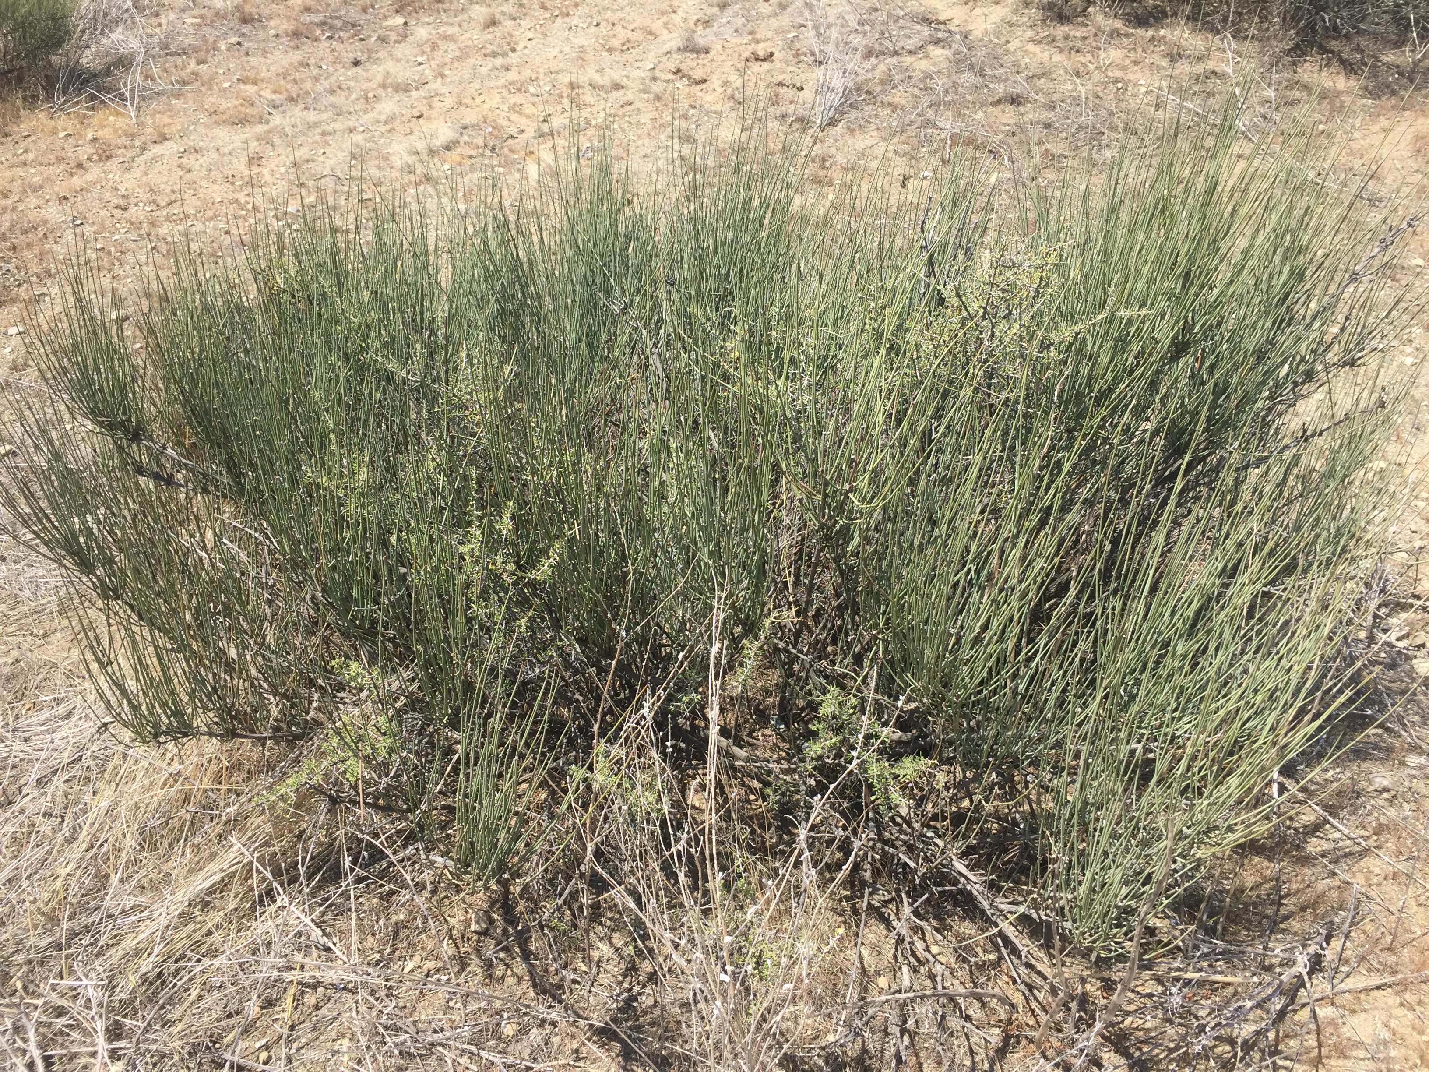
Chapter 2: An examination of shrub and animal density-dependent interactions in desert ecosystems
Notes:
I just wanted to go back and give a quick reminder of my chapter 2. My chapter 2 will focus primarily on the Ephedra Californica in the Carrizo Plain national monument in California (an arid environment). This foundational species has been seen to interact with various other species in this ecosystem in an indirect and direct way. Direct interactions such as acting as a resource, protecting from predators and acting as a refuge, are jusr some minor examples of how these woody shrubs can benefit animal species. As for indirect interactions, shrubs provide a “microclimate” that are usable for species to escape the extreme heat in these arid ecosystems.
So I want to see that if there if varying densities of this foundational species will have an impact on the total abundance and interactions of other species, that are known to interact with the Ephedra Californica. The main ways I plan on doing this is through the use of camera traps (where there will be 2 set up at each established microsite at opposite ends, looking into the site) running transects near each of the microsites, and by dedicating an hour to each site to run focal observations.

Slide 17

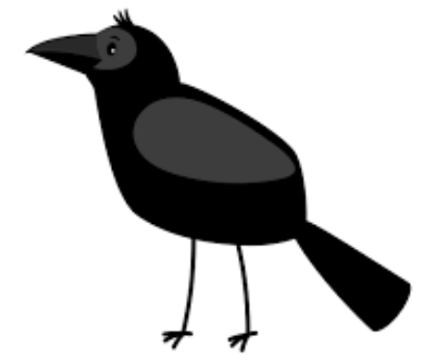
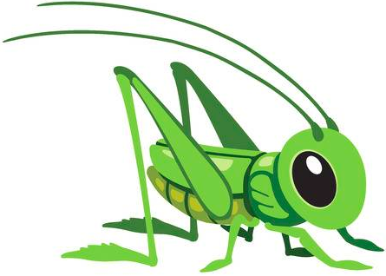
Chapter 2: An examination of shrub and animal density-dependent interactions in desert ecosystems
Purpose:
To examine the density dependent interactions between shrub and animal species in desert ecosystems
Notes:
Here is just a quick run through of the purposes of the project and the main questions I want to answer while out in the field and analyzing the data.

Slide 18
Chapter 2: An examination of shrub and animal density-dependent interactions in desert ecosystems
Question:
Is there a relationship between the shrub density and animal density in the Carrizo Plain?
Do animal populations respond to shrub density
How are the varying species interacting with the shrubs?

Slide 19
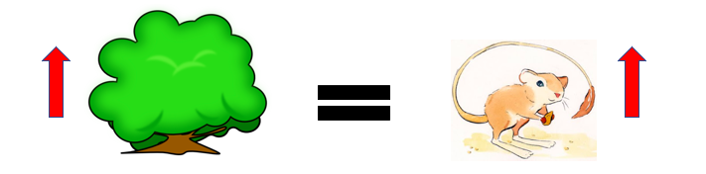
Chapter 2: An examination of shrub and animal density-dependent interactions in desert ecosystems
Hypothesis:
The frequency of frequency will increase with increasing densities of benefactor shrubs and/or interacting animals but resource limitations are an important cofactor

Slide 20
Chapter 2: An examination of shrub and animal density-dependent interactions in desert ecosystems
Predictions:
Higher Shrub density will correlate with a higher animal species density.
Shrub and animal densities positively covary
High shrub densities also increase animal species richness
Larger shrub size will have a positive impact on animal density

Slide 21
Chapter 2: Progress so Far
Notes:
Unfortunately due to weather conditions while conducting a mini-field season in January, I was unable to go out to the Carrizo Plain site to measure shrub densities at my previously designated sites. So instead I ran a sample measurement at a different site to see how the protocol would work.
The image on this slide is a picture of the Panoche Plateau. This site has a species of ephedra with varying densities. I felt it would be a good idea to run a practice trial of establishing my microsites (similar to the ones I am setting up at Carrizo) and see how the density varies. The coordinates of the site are (36.69718 -120.79865).

Slide 22
Methodology
Randomly selects 10 sample microsites in close proximity to main path
Establish center of microsite and measure 20m outward. Take GPS location of center of Microsite
Establish radius of microsite
Measure all Ephedra shrub species in microsite including; x = longest length, y = 90 degree adjacent to x measure, and z =height
Take GPS location of shrub
Notes:
The above is the methodology used during the pilot study out at the Panoche Plateau. Read methods and go a bit more into detail

Slide 23
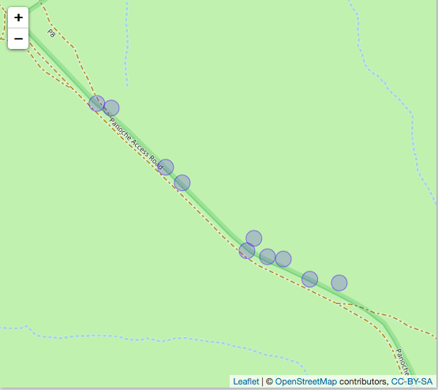
Chapter 2: Progress so Far
Notes:
So while out in the Panoche Plateau we measure 10 different sites. These 10 sites were randomly selected near the main path, and the gps location taken for the center of each microsite. Using a transect tape we measured out each site’s radius and from there measured the dimensions of each ephedra shrub in the microsite. We used x, y ,z dimensions where x was the longest portion of the shrub, y is the length 90 degrees from the x value and z is the height of the shrub. Each shrubs then had it’s gps coordinates taken.

Slide 24
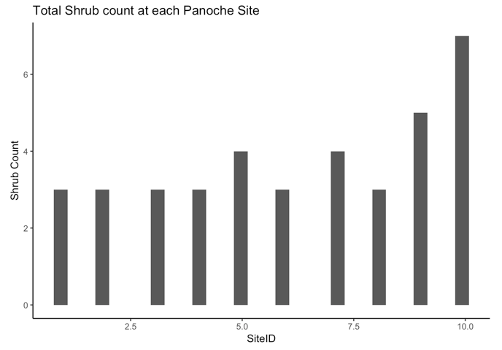
Chapter 2: Progress so Far
Notes:
After all the data was inputted, I analyzed it a bit and found the total density of ephedra shrub per microsite. What I noticed was that on average, the majority of the sites had about 3 shrubs. I would classify this as a ”low” density since this was the lower end of shrub abundance at the site. I then noticed that a few sites a ”medium” number of shrubs which were around 4-5 shrub individuals in a site. Finally I noticed one site had a larger density of shrubs than the others. I would have classified this as a “high” density microsite, as it had the highest abundance of shrubs of all 10 microsites.
From this practice run, I would say that the current protocol I have set for my Carrizo Sites would be optimal. Since I have sites already planned based on GPS coordinates and imaging, I think that the sites I have established best represent a gradient ranging from high, medium and low density. The practice run I conducted displays that it is possible to find a gradient of shrub densities at my sites and that it would be a good representation.

Slide 25
In-depth Timeline
Timeline | Goals
February 2019 | Travel to Carrizo study site to get preliminary data on potential sites. Pick potential sites.
March 2019 | Work with data collected from February trip.
April 2019 | Continue working with data collected from February trip, work on write up for Chapter 1
May 2019 | Travel to Carrizo site, acquire camera traps and SD cards. Deploy cameras at sites (Chosen in February). Conduct focal observations and transects
June 2019 | Return from field site. Begin analyzing data from camera traps, transects and focal observations. Continue work on Chapter 1.
July 2019 | Continue working with dataset from May field month. Continue work on Chapter 1.
Notes:
Go over timeline

Slide 26
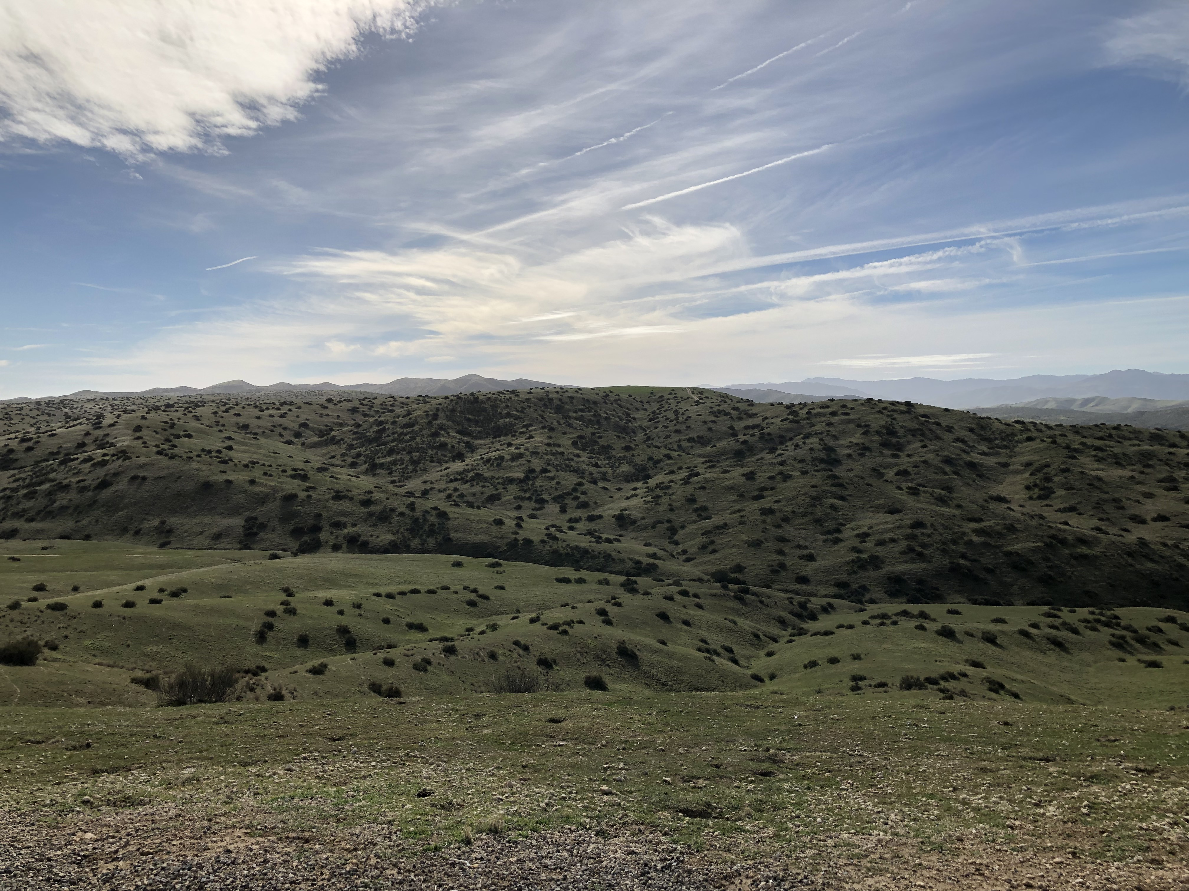
Thank You! ☺

